Slide 1
Week 11
Midterm and Methods

Slide 2
Dagsorden
Midterm
What is a method?
Signature
Parameters
Practical usage
Review
Find todays materials on GitHub.

Slide 3
Midterm

Slide 4
What are methods?

Slide 5
Define “method”
A method is a code block that contains a series of statements. A program causes the statements to be executed by calling the method and specifying any required method arguments. In C#, every executed instruction is performed in the context of a method.
- MSDN
For a more on how methods work on a lower-level, see "What is a method?" on GitHub.

Slide 6
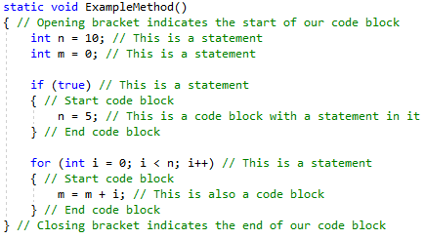
A method is a code block that contains a series of statements.
{..} indicates a code block
Variable assignment is a statement
Control structures are statements
...everything you type here is a statement

Slide 7
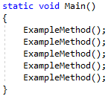
A program causes the statements to be executed by calling the method and specifying any required method arguments.
Methods may be called repeatedly
Methods are case sensitive
“Don’t Repeat Yourself” (DRY)

Slide 8
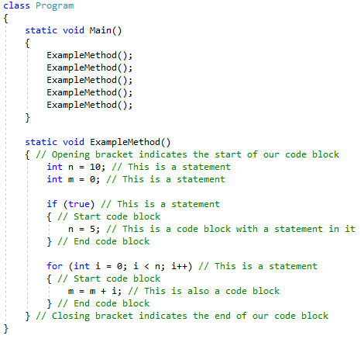
In C#, every executed instruction is performed in the context of a method.
Every piece of logical code in your program will be inside of a method
Notice that methods are defined on a class

Slide 9
Task: methods calling methods
Create 3 classes:
Foo
Baz
Bar
Every class contains one static method: public static void Call()
Foo.Call() should call Baz.Call()
Baz.Call() should call Bar.Call()
Bar.Call() should print “Hello World” to the console
Call Foo.Call() in Main()
Solution on GitHub

Slide 10
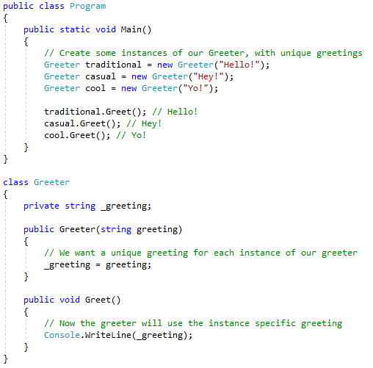
Introducing state
Constructor is a method that initializes the object to have a valid state
Methods may refer to other class members (such as attributes)
Basis for everything object-oriented

Slide 11
Signature

Slide 12
A method consists of two things
A signature (the head)
An implementation (the body)
At least that’s the simple explanation.

Slide 13
The signature simplified
[modifiers] <return_type> <name>([parameters])
modifiers are optional (defaults to private)
return_type is required and can be any data type (can be void)
name is required and can be anything (with certain rules)
parameters are optional (you still need parenthesis)
Explain the parts in this signature:

Slide 14
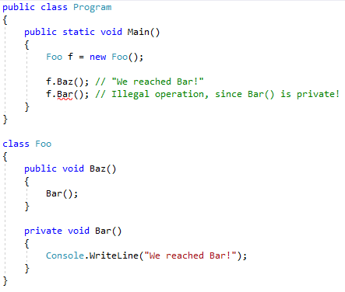
Modifiers
Access (public/private)
Scope (static)
...and many more, do you know any?

Slide 15
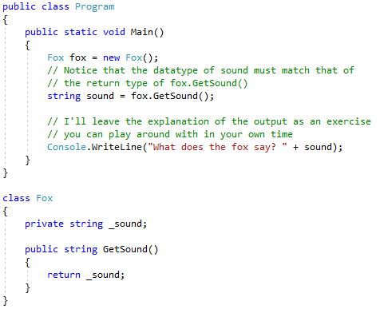
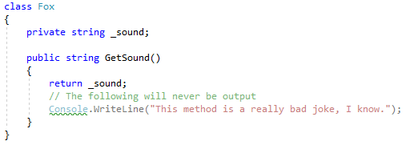
Return type
Any data type
Method must return a value
Method exits upon return
C# is strongly typed
When would we use a return type?

Slide 16
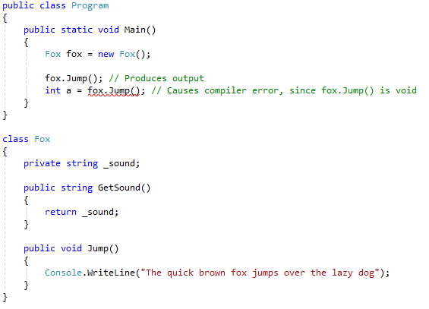
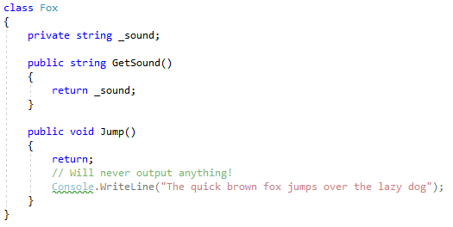
Return type
Can be void
Method must not return a value
Method can exit using return
When would we use void?

Slide 17
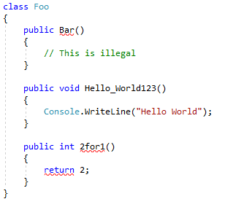
Name
A constructor method MUST be named the same as the containing class
A method name MUST only contain alphanumeric characters, numbers, and underscores
A method name MUST NOT begin with a number

Slide 18
Parameters

Slide 19
What are parameters?
A set of variables which the method uses in some way
Formally different from “arguments” - loosely interchangeable
It's typically said that you "pass" values into a method through it's parameters, in the form of "arguments". An argument is formally different from a parameter in context, in the sense that a parameter the formal variable defined in the method signature, whereas an argument is the actual value passed into the method through a parameter.
See more in “Parameters” on GitHub.

Slide 20
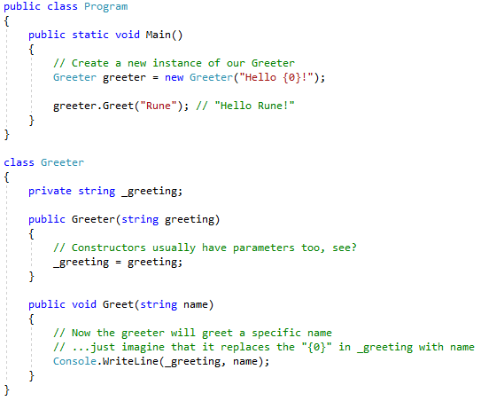
Required parameters
Make methods more dynamic
Can modify method behaviour
Where have you previously used parameters?

Slide 21
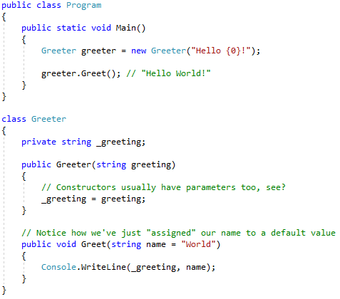
Optional parameters
Has its use cases
Can cause confusion
How would I make it output “Hello Rune” again?

Slide 22
Task: change of behaviour
Make a Greeter
Change the Greet(string name) method to take two parameters:
string name
bool yell
If yell is true, append an exclamation point (!) to the greeting
Solution on GitHub

Slide 23
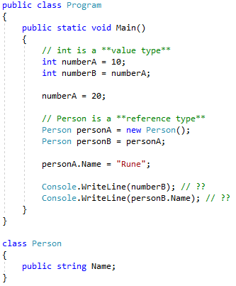
Value and reference types

Slide 24
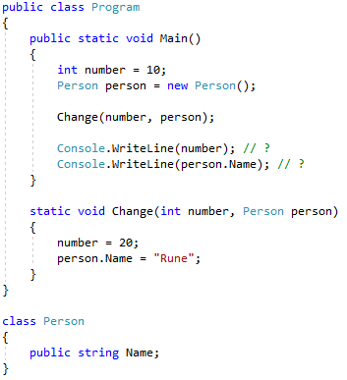
Pass by value

Slide 25
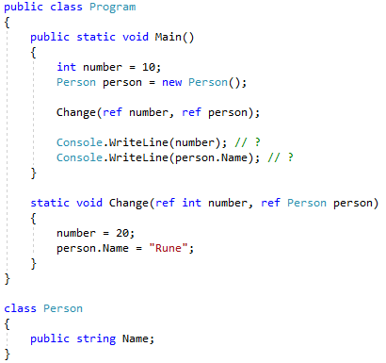
Pass by reference (using ref)

Slide 26
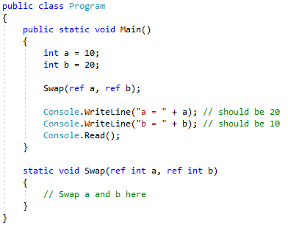
Task: swapping values
Create a method static void Swap(ref int a, ref int b) in Program
Implement the Swap() method so that it swaps the values of a and b - a should have the old value of b, and b should have the old value of a
Solution on GitHub

Slide 27
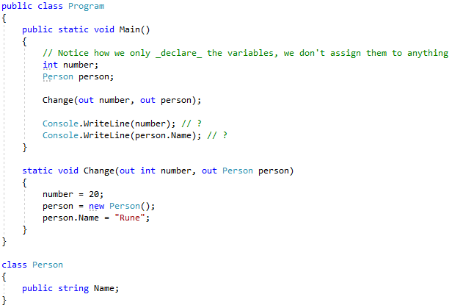
Pass by reference (using out)

Slide 28
Task: parsing user input
Using the built in method int.TryParse(string input, out int result) create a program that prompts a user for their favorite number, and then outputs the users favorite number squared
Solution on GitHub

Slide 29
Review

